Slide 1

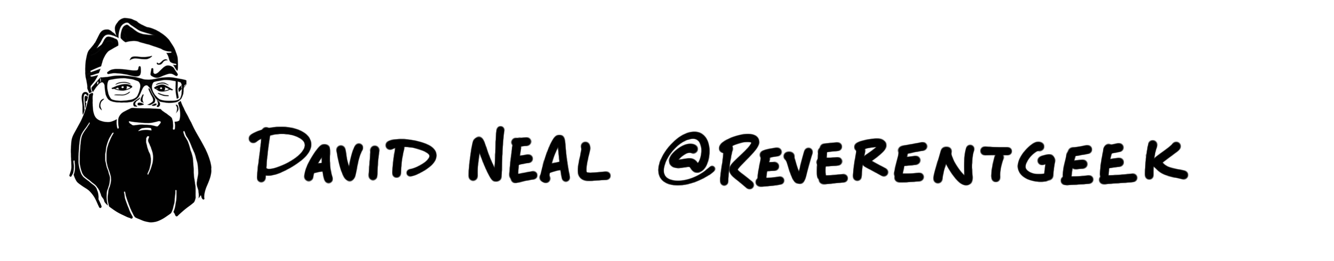
David Neal | reverentgeek.com | @reverentgeek
Notes:
I'M SO EXCITED!!!

Slide 2

Up Ahead
Create an App
Live Reload
Debug
IPC
Package

Slide 3


Slide 4


Slide 5
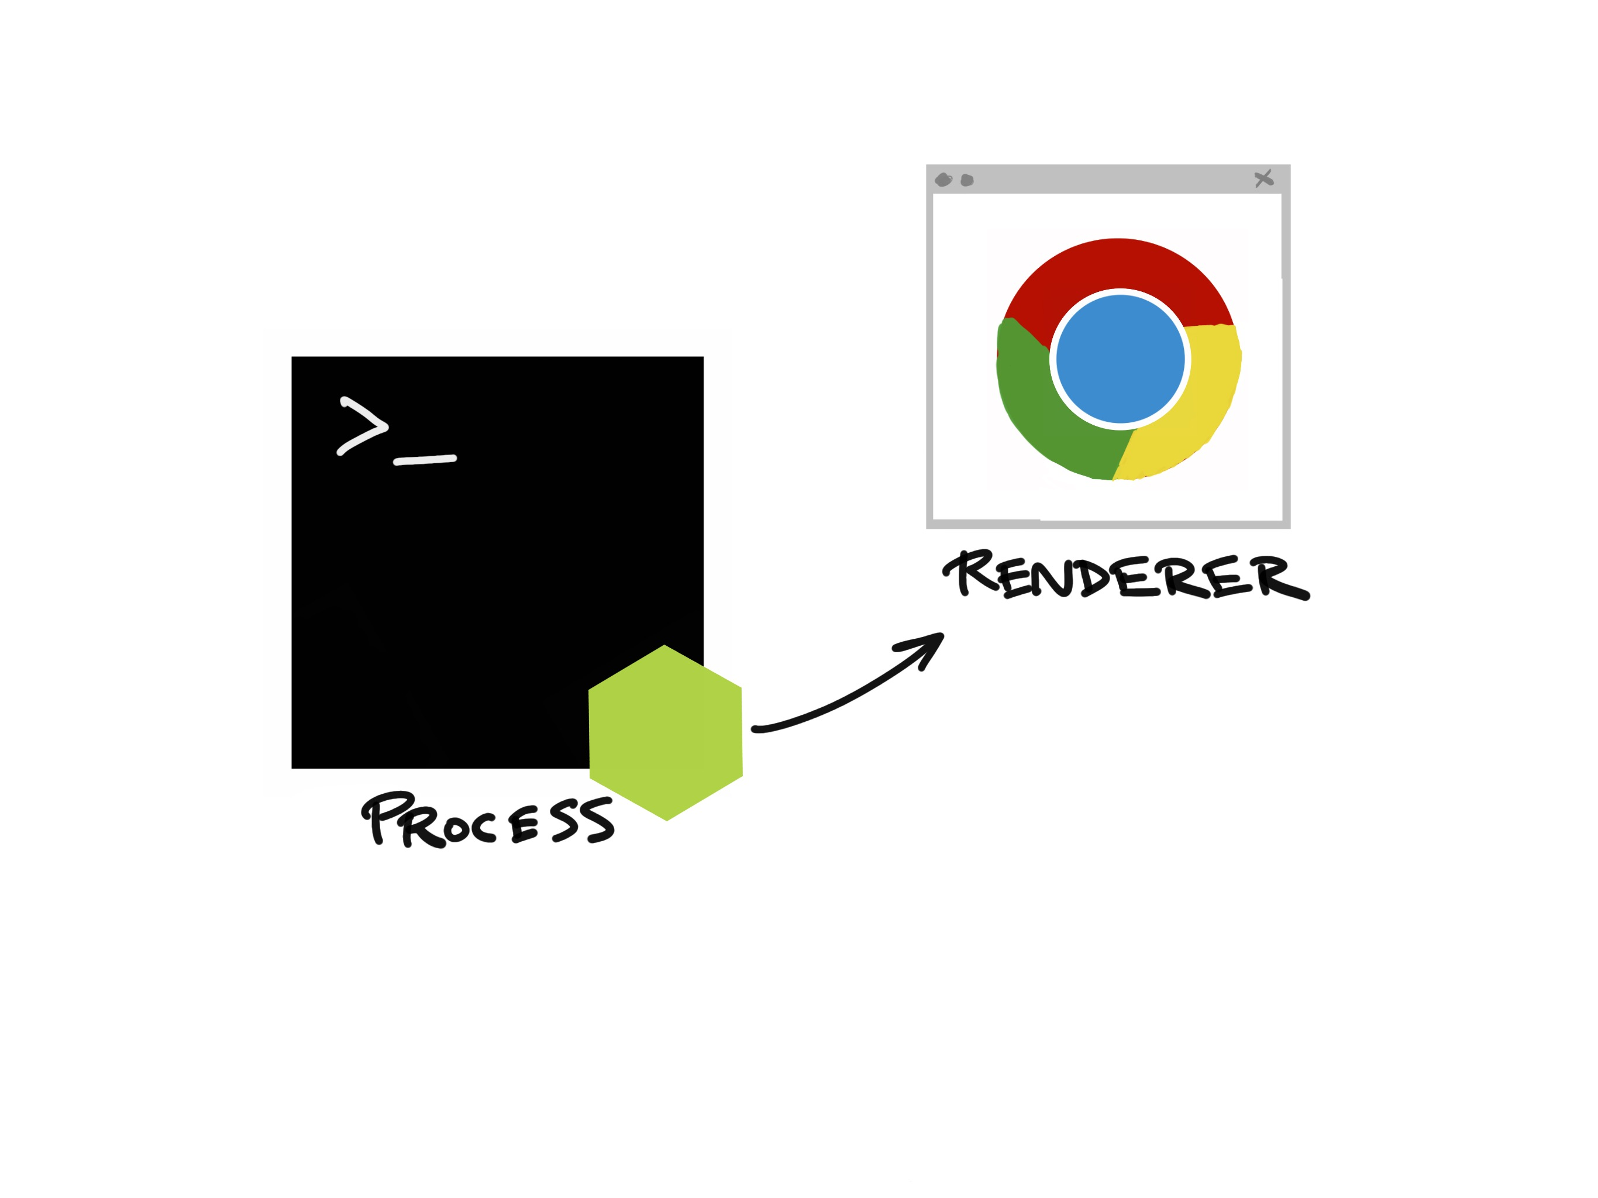
( main.js )
Notes:
Now I’d like to show you just how easy it is to get started with Electron…

Slide 6
( main.js )
Notes:
Now I’d like to show you just how easy it is to get started with Electron…

Slide 7
( index.html )
( main.js )
Notes:
Now I’d like to show you just how easy it is to get started with Electron…

Slide 8
( home.html )
( editor.html )
( settings.html )
( main.js )
Notes:
Now I’d like to show you just how easy it is to get started with Electron…

Slide 9
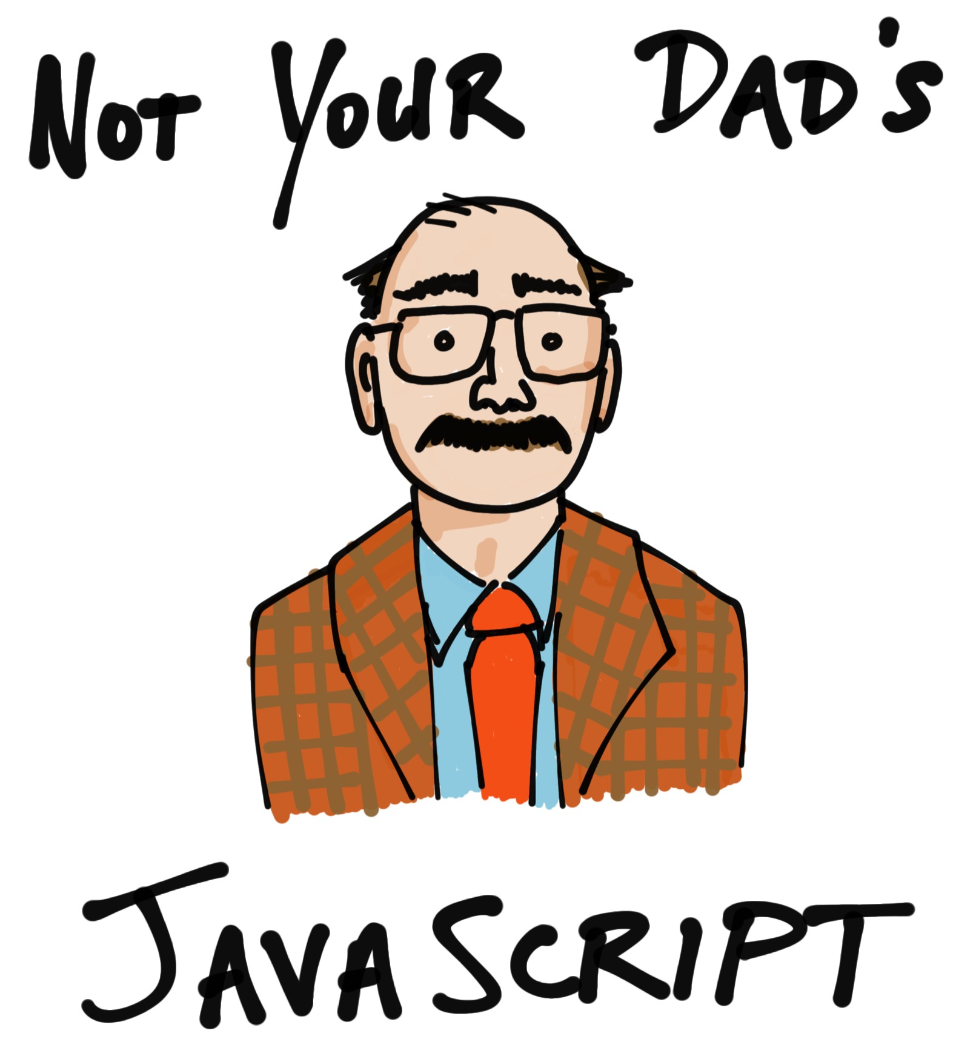
Notes:
Now I’d like to show you just how easy it is to get started with Electron…

Slide 10
Let’s Get Started!
http://bit.ly/electron-workshop
- or –
https://github.com/reverentgeek/electron-workshop/wiki

Slide 11


Slide 12


